Slide 1




PDS
Computer Vision
Cloud Infrastructure
DeepOps Cluster API_ Kubernetes
.
https://github.com/siagianp
https://www.youtube.com/@AmelOline/videos
https://github.com/amelcharolinesgn2/Cloud-Infrastructures
https://github.com/amelcharolinesgn2/ClouD-Infrastructure-SISKA-2025
https://github.com/amelcharolinesgn2/CCNA-1-v7
https://github.com/amelcharolinesgn2/CCNA-2-v7
https://github.com/amelcharolinesgn2/CCNA-3-v7
https://github.com/amelcharolinesgn2/CCNA-4-v7
https://github.com/amelcharolinesgn2/ANJAR_CCNP_Lab
https://github.com/amelcharolinesgn2/CloudSim
https://github.com/amelcharolinesgn2/AWS Certificate
https://github.com/amelcharolinesgn2/OpenStack
https://github.com/amelcharolinesgn2/IoT_simulator-mqtt-NodeRed
Notes:
https://developer.nvidia.com/blog/deploying-rich-cluster-api-on-dgx-for-multi-user-sharing/

Slide 2
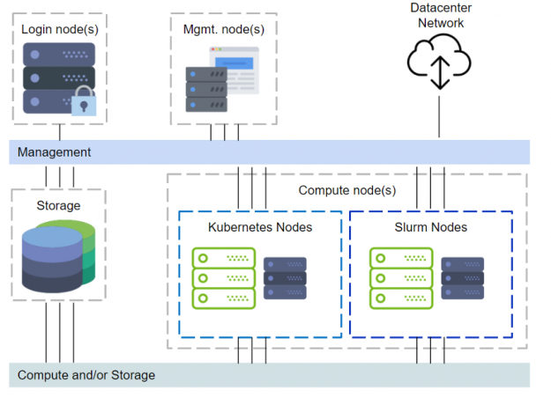
DeepOps cluster API
Figure 1 illustrates a cluster with the DeepOps components.
DeepOps covers setting up login nodes, management, monitoring, Kubernetes, Slurm, and even storage provisioning.
Figure 1. DeepOps view of cluster management.
Notes:
https://developer.nvidia.com/blog/deploying-rich-cluster-api-on-dgx-for-multi-user-sharing/

Slide 3
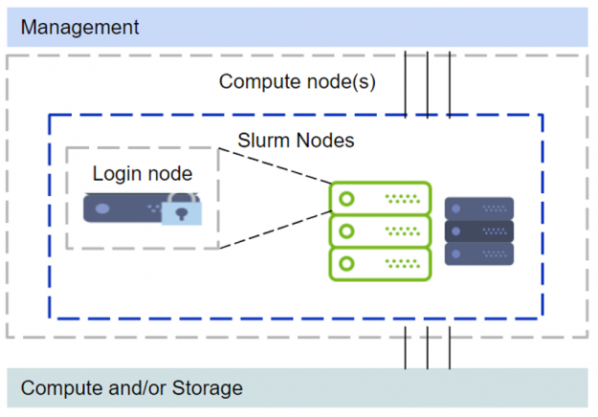
Management
DeepOps covers setting up login nodes, management, monitoring, Kubernetes, Slurm, and even storage provisioning.
The above setup with management nodes, Kubernetes and other components would require additional servers, either physical or virtual, to be provisioned. Some organizations might acquire just DGX systems, and even with one node this will be sufficient without additional servers to set up a multi-user environment. However, deploying Kubernetes with just one node is not supported. Refer to the “Zero to Data Science” blog on deploying Kubernetes. We will rely on Slurm for the cluster resource manager and scheduling. This limited scope is illustrated in Figure 2.
Since the major difference in this setup is that one of the compute nodes functions as a login node, a few modifications are recommended. The GPU devices are restricted from regular login ssh sessions. When a user needs to run something on a GPU they would need to start a Slurm job session. The requested GPUs would then be available within the Slurm job session.
Additionally, in multi-user environments one typically wants to restrict elevated privileges for regular users. Rootless docker is used with the Slurm setup to avoid granting elevated rights to end users running containers. Rootless docker solves a couple problems. 1. The users can work in a familiar fashion with docker and NGC containers; 2. There is no need to add users to a privileged docker group; 3. The rootless docker sessions will be constrained to the Slurm job resources (privileged docker can bypass Slurm allocation constraints whereas rootless cannot).
Figure 2. Simplified cluster management with one of the compute nodes functioning as a login node.
Notes:
https://developer.nvidia.com/blog/deploying-rich-cluster-api-on-dgx-for-multi-user-sharing/

Slide 4
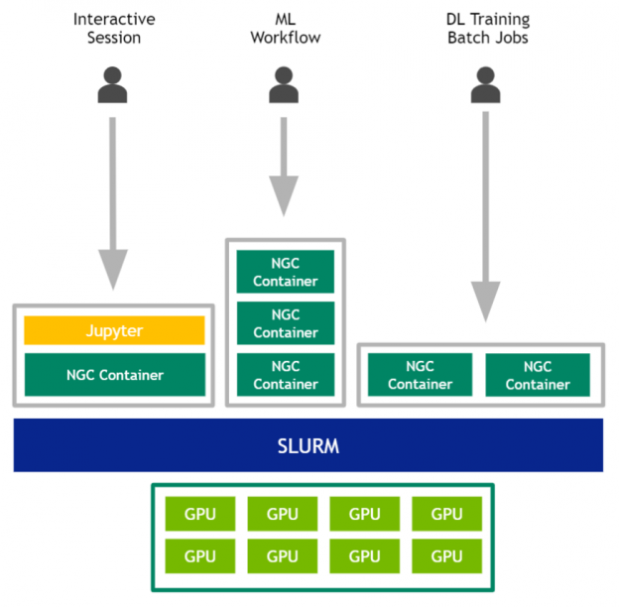
Monitoring
DeepOps covers setting up login nodes, management, monitoring, Kubernetes, Slurm, and even storage provisioning.
igure 3. Multi-user team sharing a DGX system and its GPUs for various workloads.
Notes:
https://developer.nvidia.com/blog/deploying-rich-cluster-api-on-dgx-for-multi-user-sharing/

Slide 5
PDS
Computer Vision
Nvidia Docker Kubernetes 2025
.
https://github.com/siagianp
https://www.youtube.com/@AmelOline/videos
https://github.com/amelcharolinesgn2/IoT_simulator-mqtt-NodeRed
https://github.com/amelcharolinesgn2/Cloud-Infrastructures
https://github.com/amelcharolinesgn2/ClouD-Infrastructure-SISKA-2025
Notes:
https://developer.nvidia.com/blog/deploying-rich-cluster-api-on-dgx-for-multi-user-sharing/

Slide 6
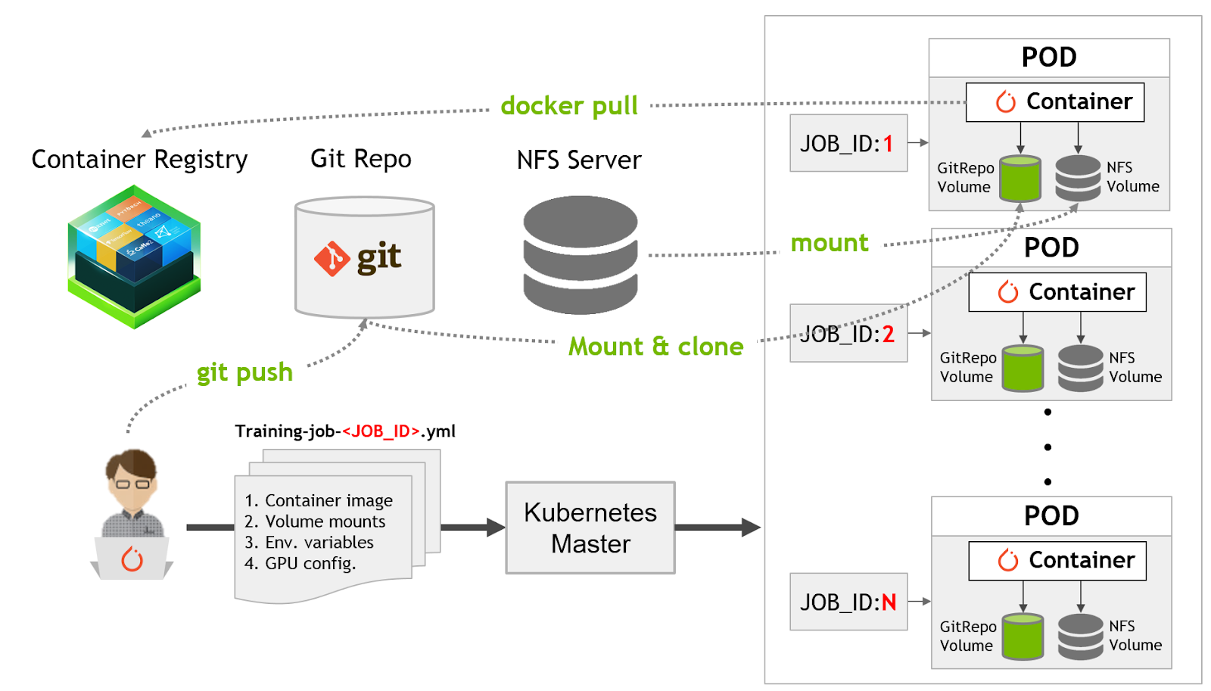

Slide 7
PDS
Computer Vision
Docker Swarm
.
https://github.com/siagianp
https://www.youtube.com/@AmelOline/videos
https://github.com/amelcharolinesgn2/IoT_simulator-mqtt-NodeRed
https://github.com/amelcharolinesgn2/Cloud-Infrastructures
https://github.com/amelcharolinesgn2/ClouD-Infrastructure-SISKA-2025
Notes:
https://developer.nvidia.com/blog/deploying-rich-cluster-api-on-dgx-for-multi-user-sharing/

Slide 8
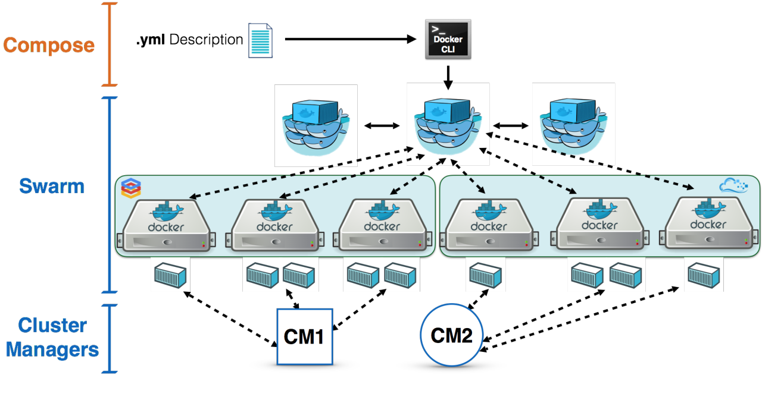
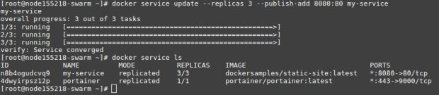
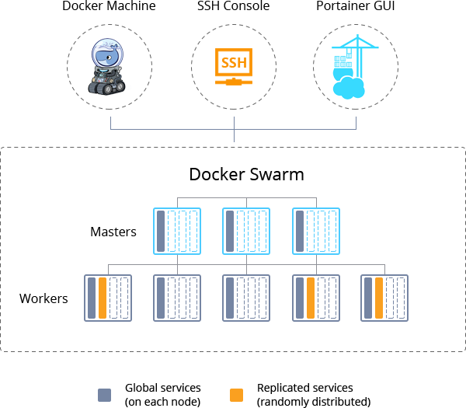

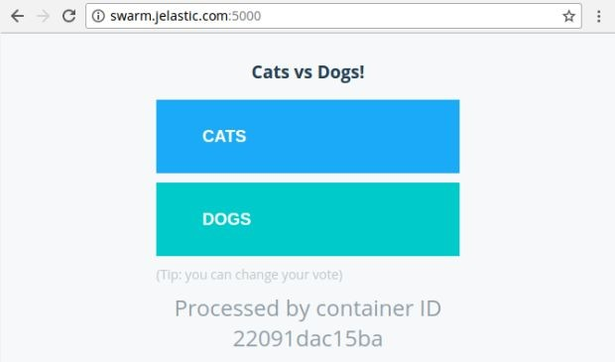
Notes:
https://pt.linkedin.com/pulse/implantando-servi%C3%A7os-ao-cluster-do-docker-swarm-edilson-freitas

Slide 9
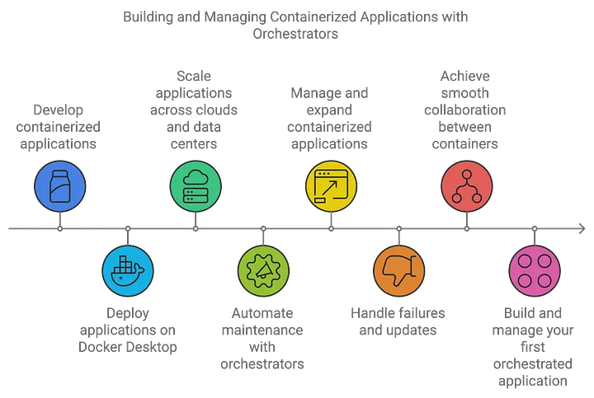
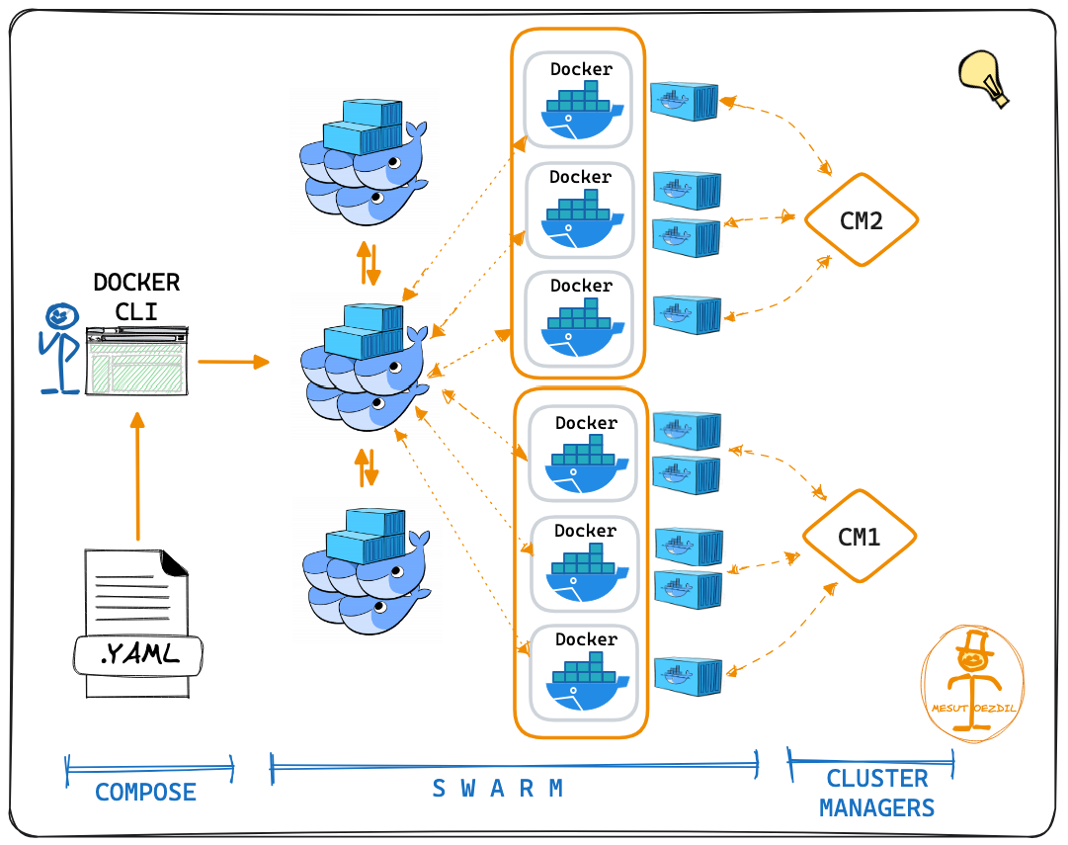
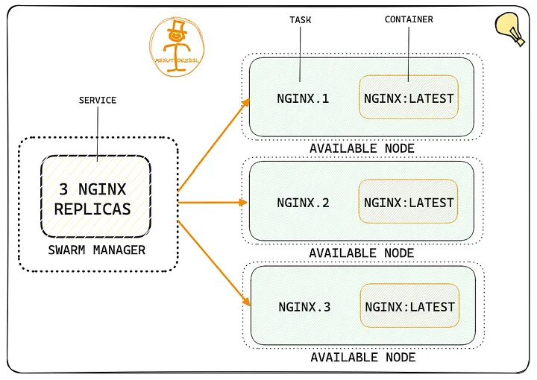
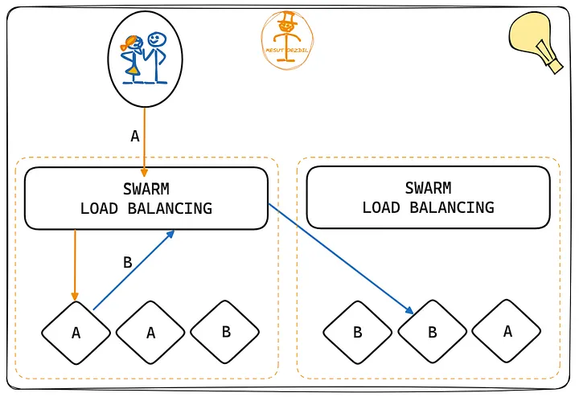
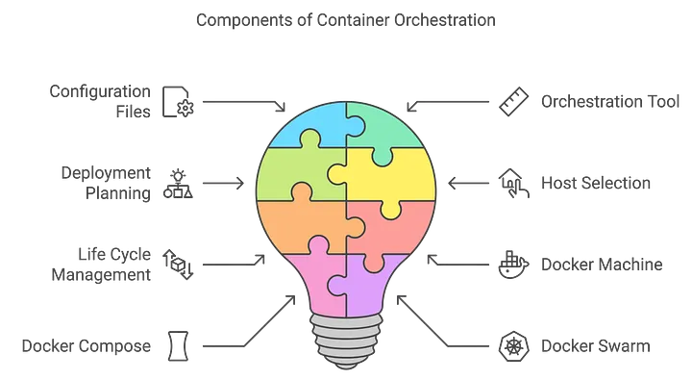
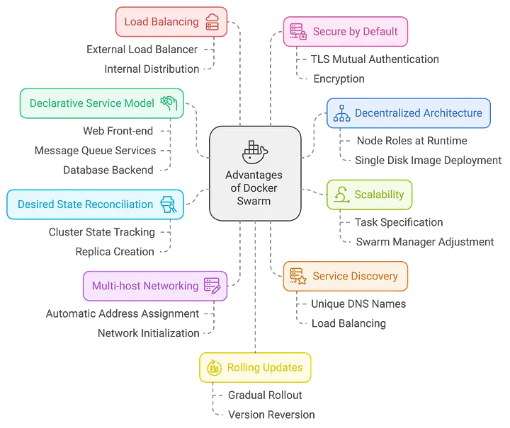
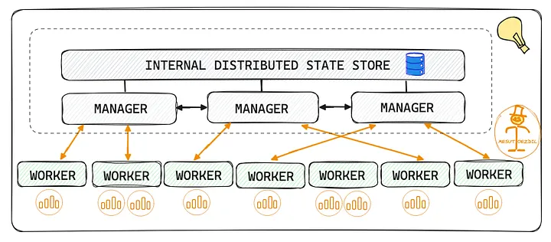
Docker Swarm. an in-depth introduction
Notes:
https://mesutoezdil.medium.com/docker-swarm-6efa43f7b68d
https://mesutoezdil.medium.com/docker-swarm-6efa43f7b68d

Slide 10
Thank you!
PDS
Computer Vision
Q&A
Thank you For being a great class!
https://github.com/siagianp
https://www.youtube.com/@AmelOline/videos
https://github.com/amelcharolinesgn2/IoT_simulator-mqtt-NodeRed
https://github.com/amelcharolinesgn2/Cloud-Infrastructures
https://github.com/amelcharolinesgn2/ClouD-Infrastructure-SISKA-2025
Notes:
https://medium.com/buildpiper/simplifying-containerization-with-docker-run-command-2f74e114f42a
https://github.com/IBA-Group-IT/IoT-data-simulator
https://www.bevywise.com/blog/docker-mqtt-broker-easy-service-manageability/

Slide 11
Reference
https://developer.nvidia.com/blog/deploying-rich-cluster-api-on-dgx-for-multi-user-sharing/

